Slide 1
Assignment 15.1: Circuit Card Inquiry lab
Victoria Maraboto
RBT125
Prof. Prater
4/28/2024

Slide 2
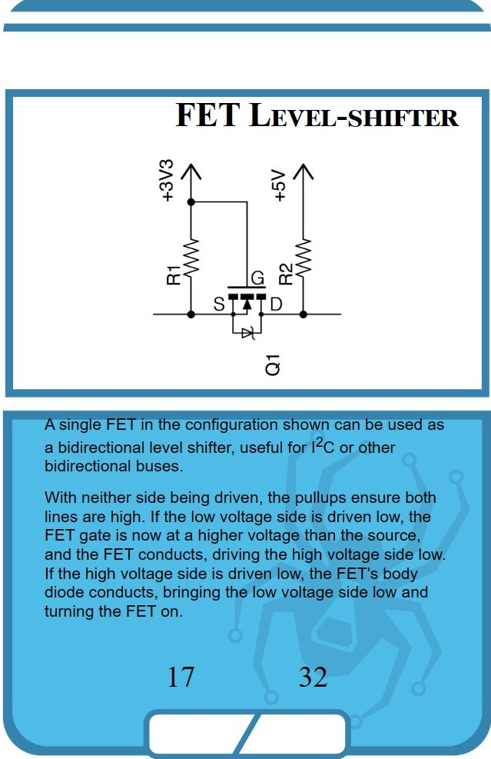
FET Level-Shifter
The main job of this circuit is to keep digital signals strong and clear while changing them between two different voltage levels. This change allows the two sides to be separated, so if one side is shut off or has a problem, the other side keeps working normally. The circuit puts a barrier between the two sides so issues on one side don't mess up the other side. It also helps reduce electrical noise and signal problems that can happen when sending signals across parts that use different voltages. By carefully fixing up the signals during the voltage change, the circuit keeps the data accurate and uncorrupted. Circuits like this are important for letting devices or components that use different voltage standards communicate and work together properly. Their ability to smoothly handle the voltage differences while keeping signals robust and reliable is really key for complex systems to operate correctly.

Slide 3
Where is the circuit used?
This circuit can be used in several different situations:
It allows microcontrollers or logic circuits that operate on different voltages to communicate with each other. This is useful when you need to connect newer, low-power chips with older, higher-voltage chips that could be from different manufacturers. The circuit translates the signals between the two different voltage levels safely.
It can also help reduce power usage in single-chip systems that have multiple parts running at different voltage levels. These chips often use lower voltages for some functions to save power. The level shifting circuit allows the low and high voltage areas to interface while preventing power leakage issues.
Additionally, these kinds of circuits come in handy anytime two parts of an electronic device use different voltages for their logic signals but still need to share data.
Essentially, the circuit acts as a safe translator between sections operating at different voltage levels, preventing damage while still allowing signals to get across reliably and clearly.

Slide 4
Advantages
Some of the main advantages of using an FET Level-Shifter circuit are:
Faster operation. The circuit can switch on and off very quickly, with rise and fall times only limited by the capacitance of the transistor gate and the driving circuitry. This makes it well-suited for applications that need rapid switching like high-speed digital communications or controlling pulses.
Smaller footprint. The level-shifter can be built using just a few individual components, so it doesn't take up much space on a circuit board. The minimal size is helpful for tight layouts or compact embedded systems.
Simple design. At its core, the circuit just uses a single transistor and a couple resistors, resulting in a straightforward setup. The uncomplicated design reduces potential failure points and can make troubleshooting easier if issues occur.
Cost-effective. With just a handful of inexpensive parts needed, FET level shifters tend to be an economical solution, especially when built discreetly instead of using integrated circuits.

Slide 5
Disadvantages
Some major downsides of using an FET Level-Shifter include:
One-way operation. The circuit can only shift voltage levels in one direction. If you need to go both ways between higher and lower voltages, you'll need two separate level shifting circuits, one for each direction. This increases complexity and board space requirements.
Potential for wasted power when idle. If the level shifter circuit is just sitting idle with the output stuck low, it will continuously drain a small amount of power through the pull-up resistor to ground. While this may be a small amount for one instance, it can add up to significantly wasted power in systems with many level shifters idling.
Slower rising edges. Because the circuit relies on a pull-up resistor to drive the output high, the rising edge transition can be relatively slow compared to pushing the output high with an active transistor. This rise time issue can limit maximum operating frequencies.

Slide 6
Variations
Instead of using a field-effect transistor (FET), you can use a bipolar junction transistor (BJT) instead. The circuit will work in basically the same way, but there may be some small differences in how it performs.
BJTs are controlled by current, while FETs are controlled by voltage. This can lead to differences in things like the input resistance, voltage gain, and how much noise there is. Generally, BJTs have higher current gain and lower output resistance compared to FETs, but they also tend to have more noise and lower input resistance.
The choice of whether to use a BJT or FET often comes down to what the circuit needs to do, things like the desired input/output characteristics, power usage, frequency response, and how tolerant it needs to be of noise. While you can swap one for the other in many circuits, BJTs and FETs have distinct trade-offs that designers need to carefully consider.

Slide 7
References
Advantages and disadvantages of FETs-TINA and TINACloud Resources. (2020). Retrieved from TINA and TINACloud: https://www.tina.com/resources/home/field-effect-transistor-amplifiers-2/1-advantages-and-disadvantages-of-fets/
High Speed High Voltage Level Shifter. (2011, 1 23). Retrieved from Forum for Electronics: https://www.edaboard.com/threads/high-speed-high-voltage-level-shifter.199967/
Level Shifter Circuits: Theory, Design & Working principle. (2022, 4 2). Retrieved from Analog Circuit Design: https://analogcircuitdesign.com/level-shifter-circuit/
Logic Level Shifters for Driving LED Strips. (2021, 3 12). Retrieved from Electric Fire Design: https://electricfiredesign.com/2021/03/12/logic-level-shifters-for-driving-led-strips/

Slide 8
References
Passive FET Level Shifter | Yeah, nah, aye. (2021). Retrieved from Yeah.nah.nz: https://yeah.nah.nz/electronics/fet-level-shifter/
Shrivastava, B. P. (2017, 11 1). Low power, high speed carbon nanotube FET based level shifter. Retrieved from 2017 International Conference on Inventive Computing and Informatics (ICICI): https://ieeexplore.ieee.org/document/8365353
What is the advantage of using Logic Shifter ICs over just building it with NMOS Transistors? (2020, 11 2). Retrieved from Electrical Engineering Stack Exchange: https://electronics.stackexchange.com/questions/530434/what-is-the-advantage-of-using-logic-shifter-ics-over-just-building-it-with-nmos

